Slide 2
Sedimentary – having no significant gaseous phase
Gaseous

Slide 3
Processes
Geologic Uplift
Rock Weathering
Congruent Dissolution Weathering
Ca₅(PO₄)₃OH + 4H₂CO₃ ➔ 5Ca⁺⁺ + 3HPO⁼₄ + 4HCO₃⁻ + H₂O
Orthophosphate
Uptake/Assimilation
Mycorrhizae
Ectotrophic
Pinaceae, Fagaceae, Betulaceae
Salicaceae
Endotrophic
Almost all cultivated plants
Steele
Epidermis
Cortex
Endodermis

Slide 4
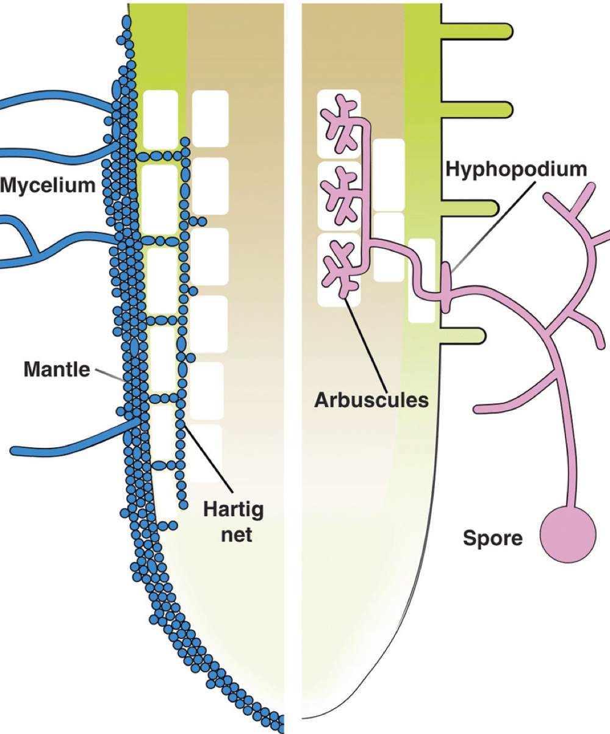
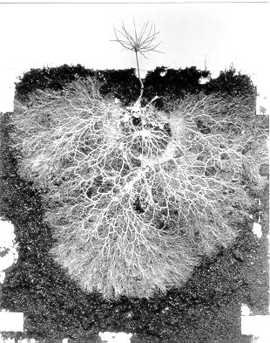
Ectotrophic mycorrhizae
Endotrophic mycorrhizae
Extensive network of mycorrhizal hyphae radiating from roots of a larch (Larix) seedling grown in peat
http://www.biology.ed.ac.uk/research/groups/jdeacon/mrhizas/ecbmycor.htm

Slide 6
Processes (Cont’d.)
Mineralization
C/P Ratio of OM Result
<200 Net Mineralization
200-300 No net change
>300 Net Immobilization
Acid Phosphatases pH optimum 4-6
Alkaline Phosphatases pH optimum 9-11
Excretion & Death
Leaching & Erosion
Sedimentation

Slide 7
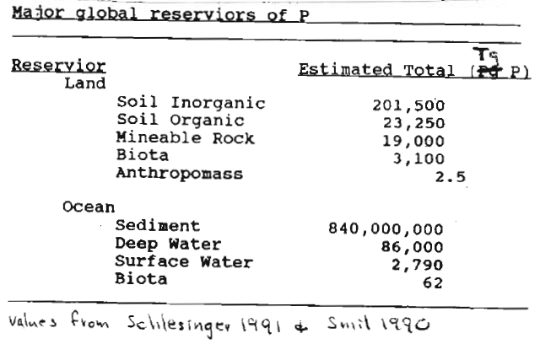
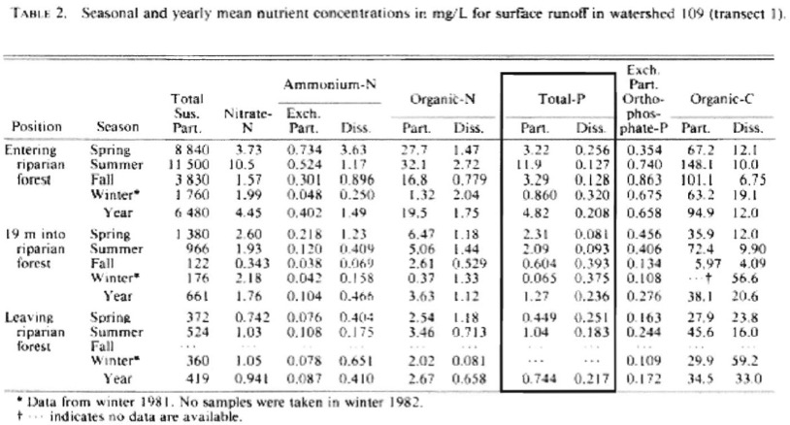

Slide 8
Where is phosphate rock found and how has its extraction changed?
Graph showing world phosphate rock production, 1900–2016, reported by US Geological Survey^{[1]}
Notes:
https://en.wikipedia.org/wiki/Peak_phosphorus

Slide 9
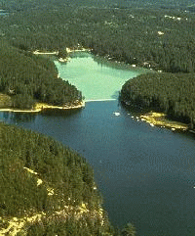
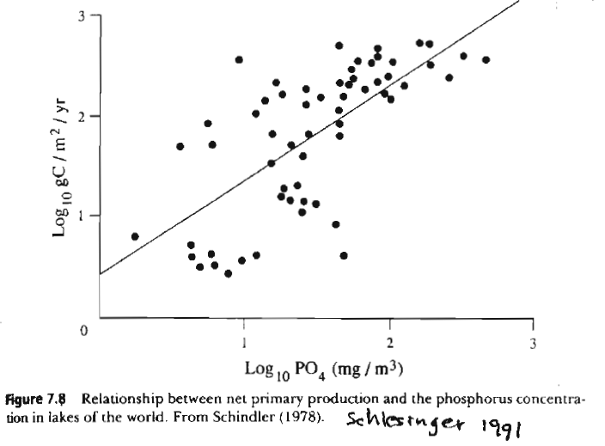
You can too much of a good thing!
Cultural eutrophication is a nutrient-induced increase
in aquatic productivity due to anthropogenic nutrient additions
P added
Waterproof
barrier
P not
added

Slide 10
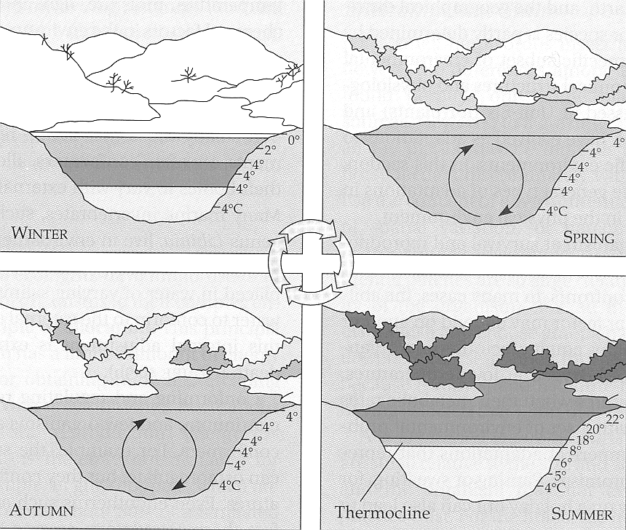
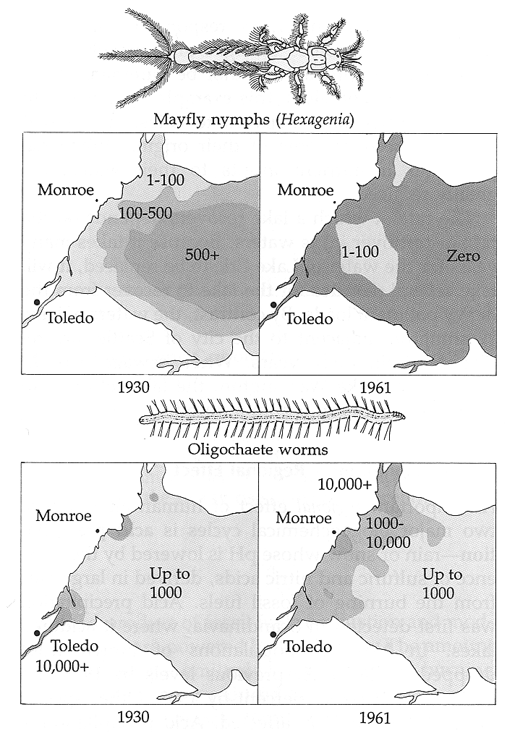
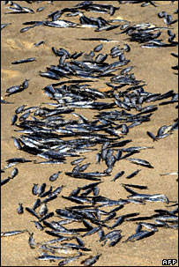

Slide 11
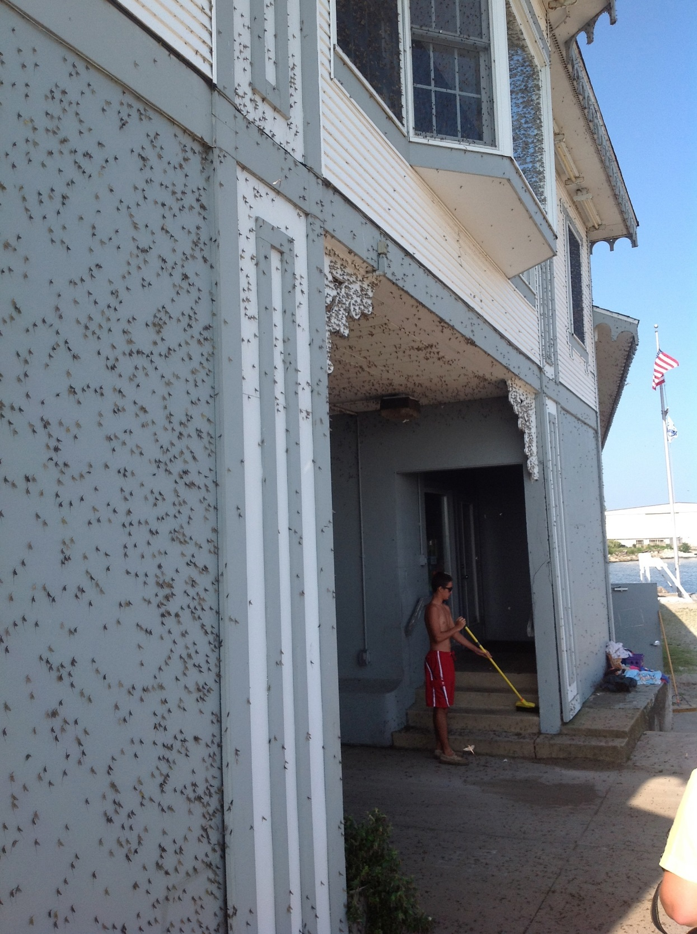
Shores of Lake Erie
Summer 2013

Slide 12
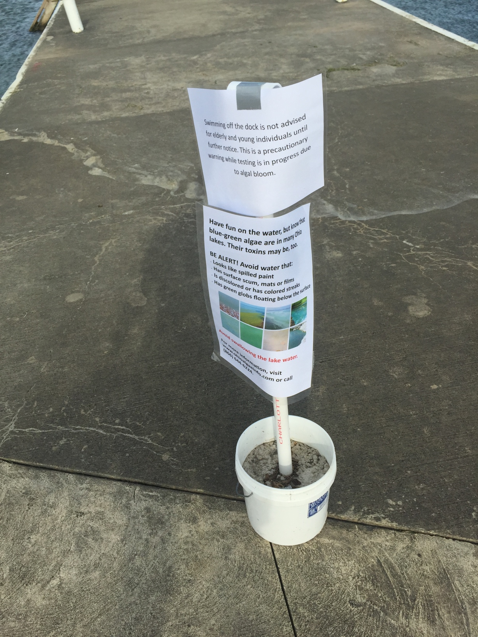
Record-setting algal bloom in Lake Erie caused by agricultural and meteorological trends consistent with expected future conditions
6448–6452 | PNAS | April 16, 2013 | vol. 110 | no. 16

Slide 14
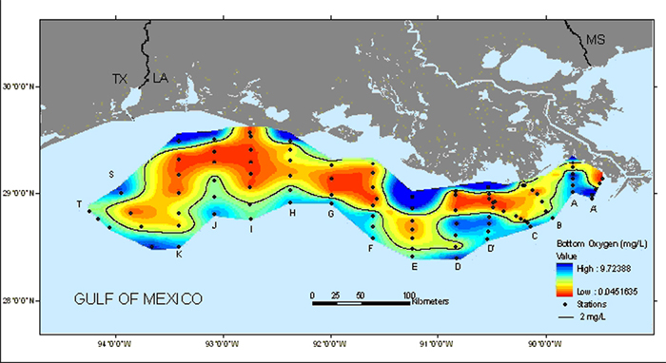
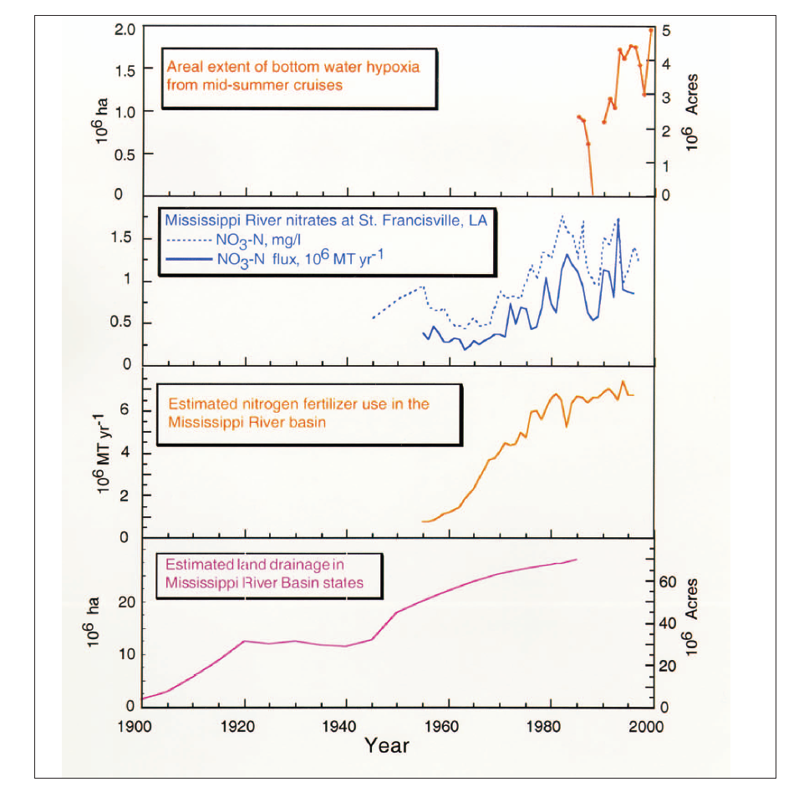
THIRD-LARGEST "DEAD ZONE" SINCE 1985
AREA SIZE OF NEW JERSEY
Mid-Summer 2007
Notes:
Mitsch et al 2001
Figure 2. Estimated 20th-century trends in hypoxia area, nitrogen concentrations,
and fluxes in the Mississippi River, nitrogen fertilizer use in the Mississippi River
Basin, and land drainage in the Mississippi River Basin (USDA 1987, Goolsby et
al. 1999, Rabalais et al. 1999).

Slide 15
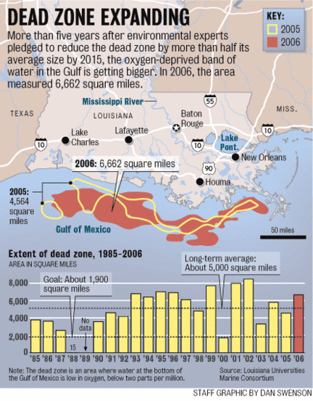
Notes:
http://blog.al.com/live/2010/08/dead_zone_in_the_gulf_of_mexic.html

Slide 16
Graph showing measured size of hypoxia zone on Louisiana Gulf of Mexico shelf, 1985–2017. Credit: LSU/LUMCON and NOAA.
Notes:
https://www.epa.gov/sites/production/files/2015-03/zonesizereplacementjan22.jpg
https://insideclimatenews.org/content/gulf-dead-zone-chokes-marine-life

Slide 17
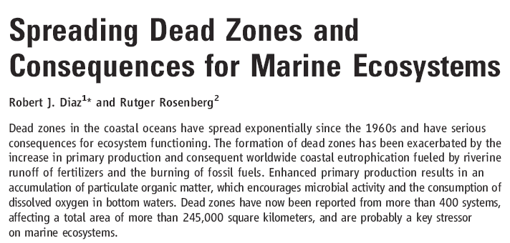

Slide 18
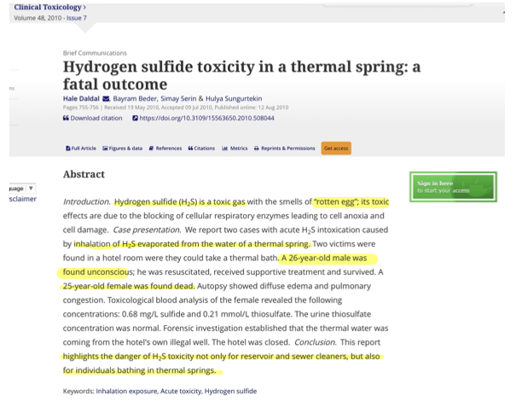

Slide 19
CO₂ + 2H₂S + hv ➔ CH₂O + 2S + H₂O
Anaerobic, green & purple sulfur bacteria

Slide 20
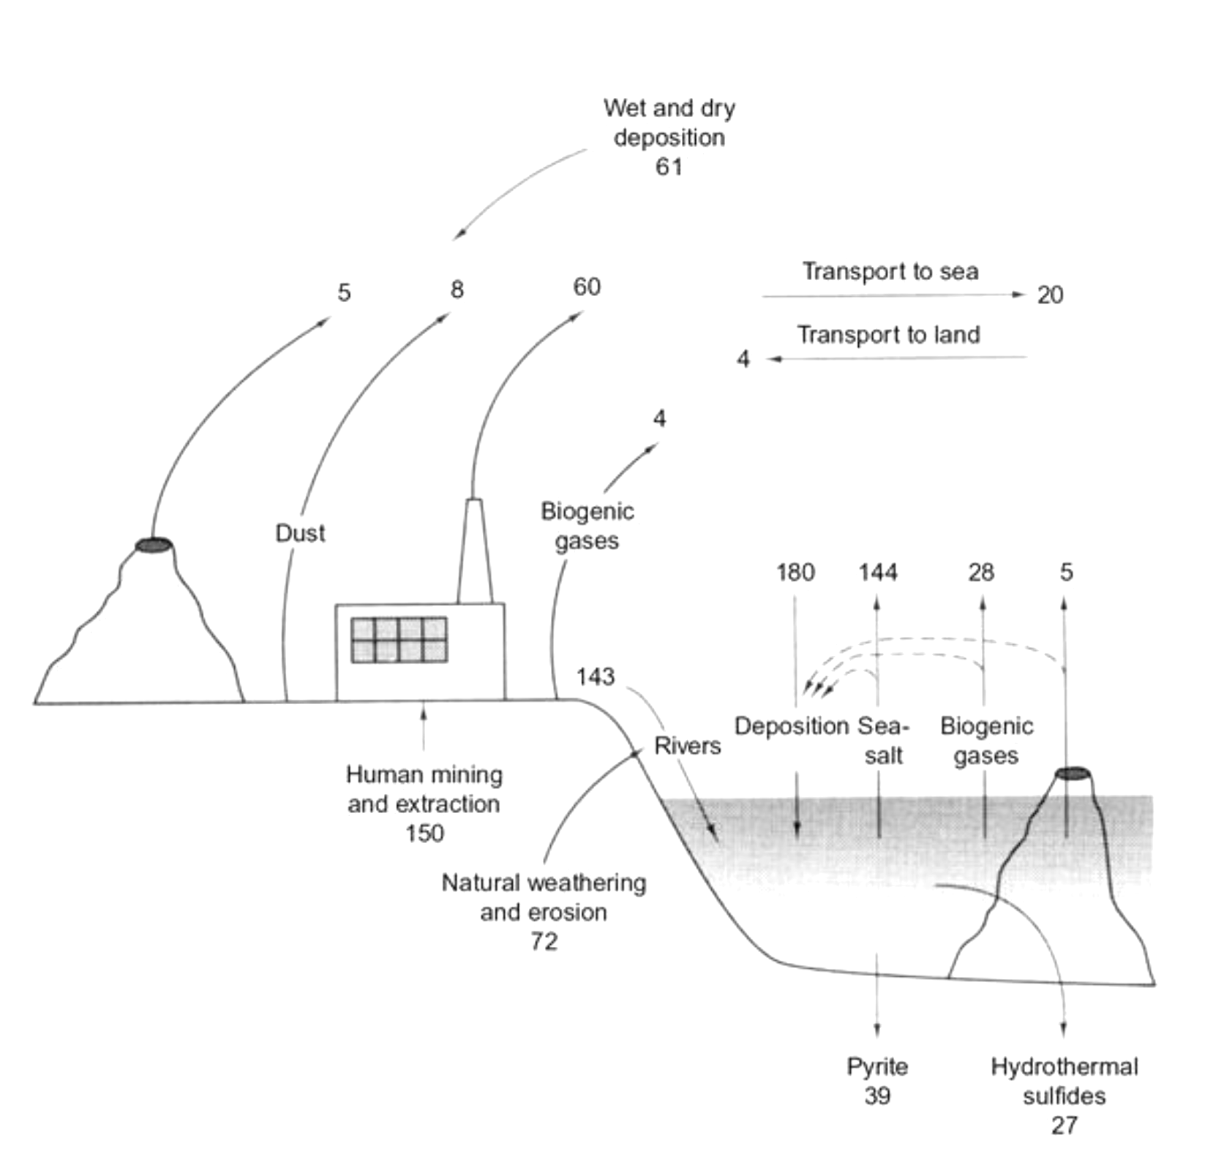
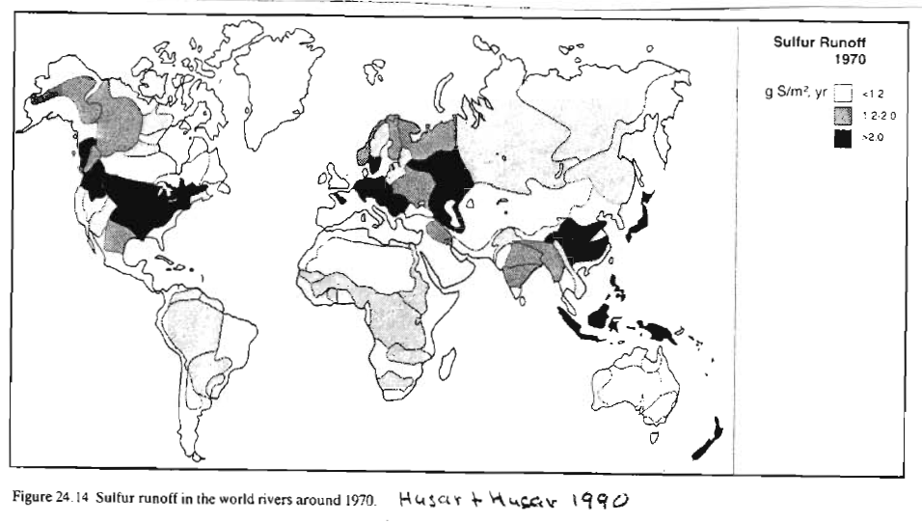
Global S Cycle
(10¹² g S/yr)
Schlesinger & Bernhardt 2013

Slide 21
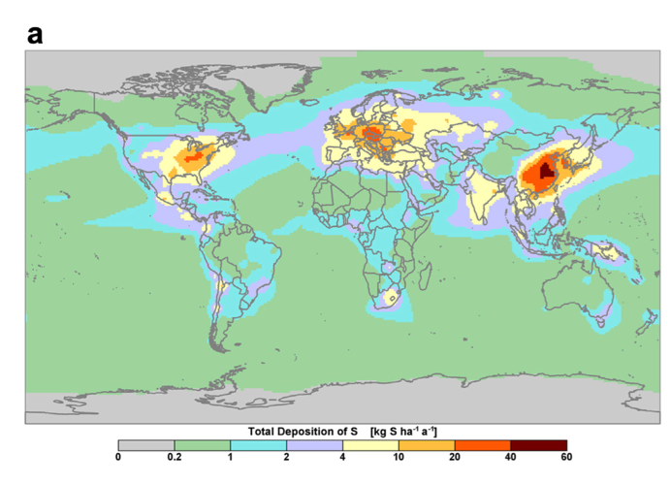
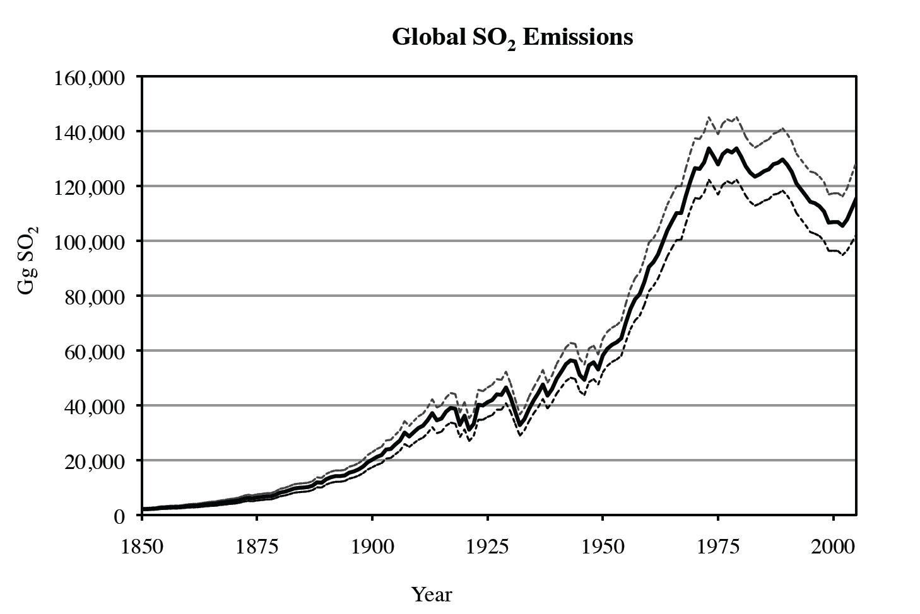
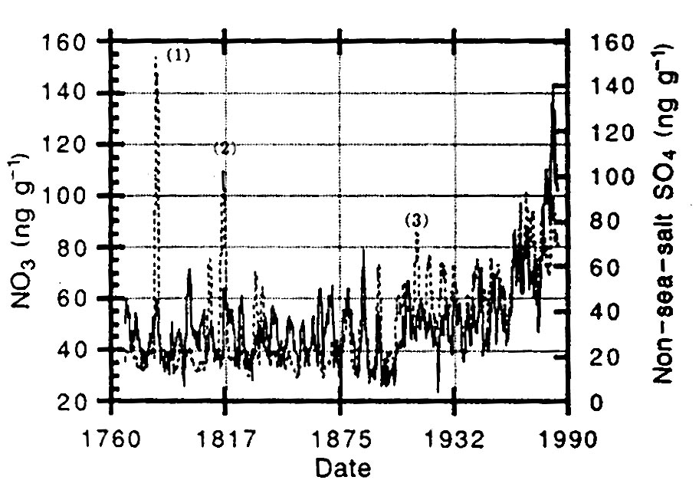
Smith et al. 2011
Mayewski et al. 1990

Slide 22
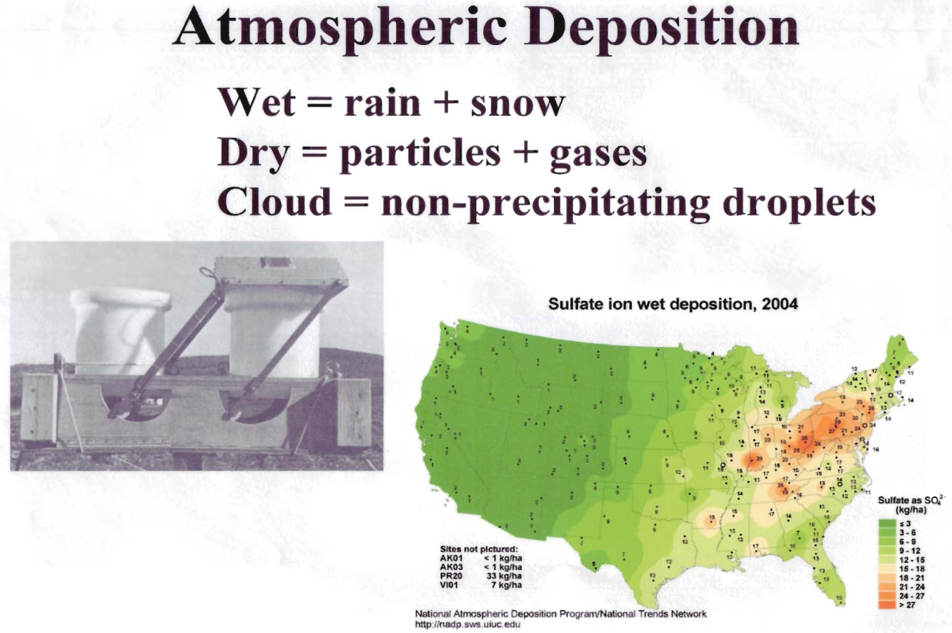
Acid deposition is more than acid rain
Acid rain
Acid snow
Acid fog
Acid dry deposition
  small particles (e.g. sulfate particles)
  uptake of acid forming gases
~80% of acid deposition

Slide 23
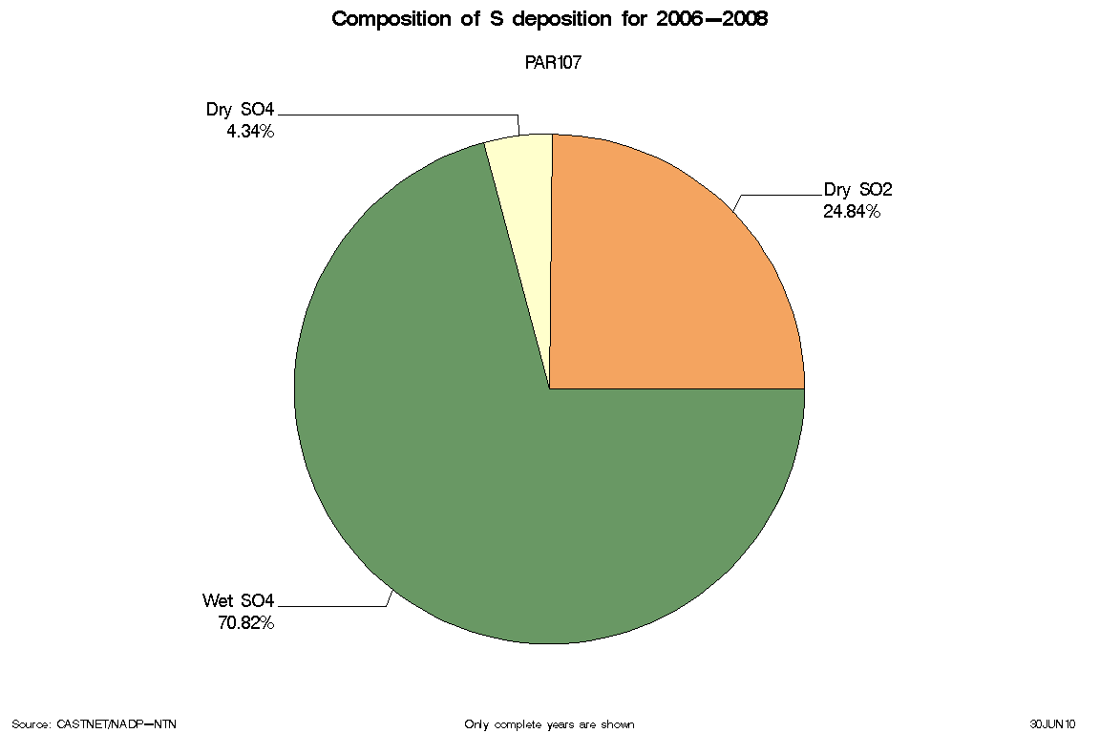
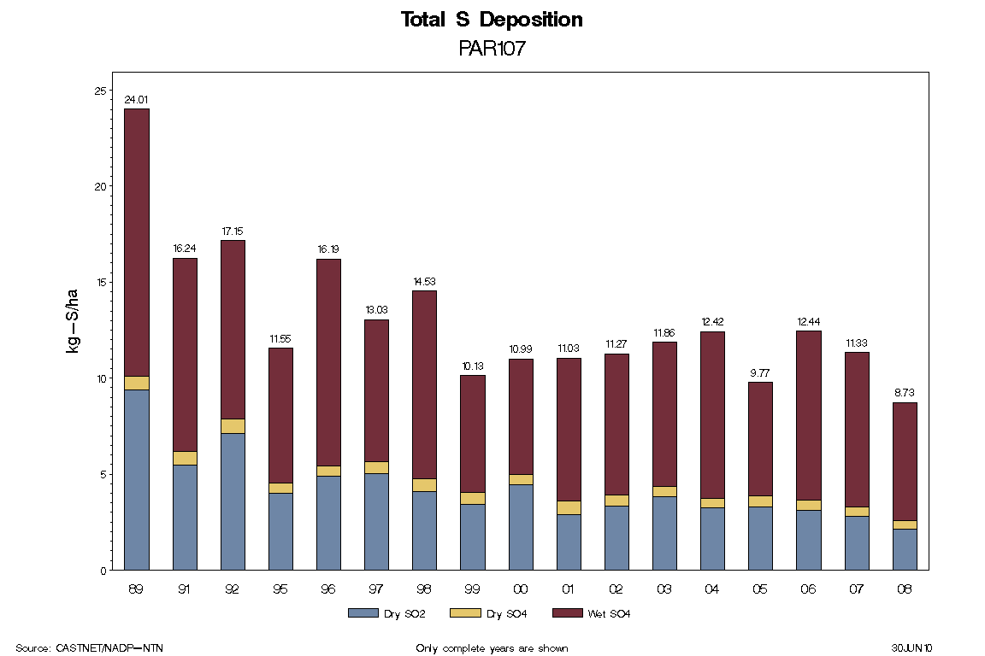
Dry & Wet Sulfur Deposition in WV
Notes:
http://www.epa.gov/castnet/sites/par107.html

Slide 24
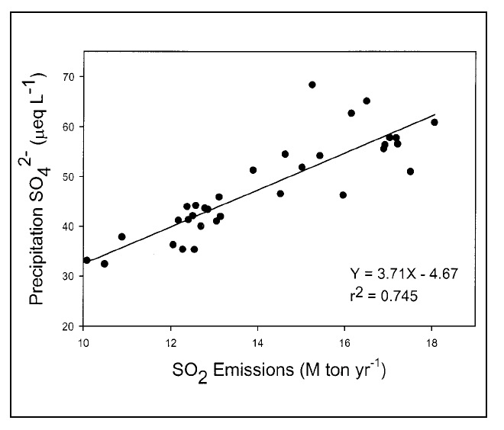
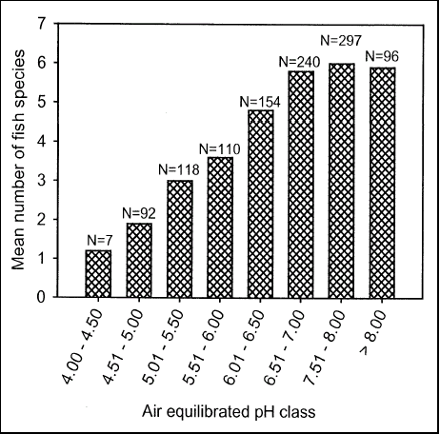
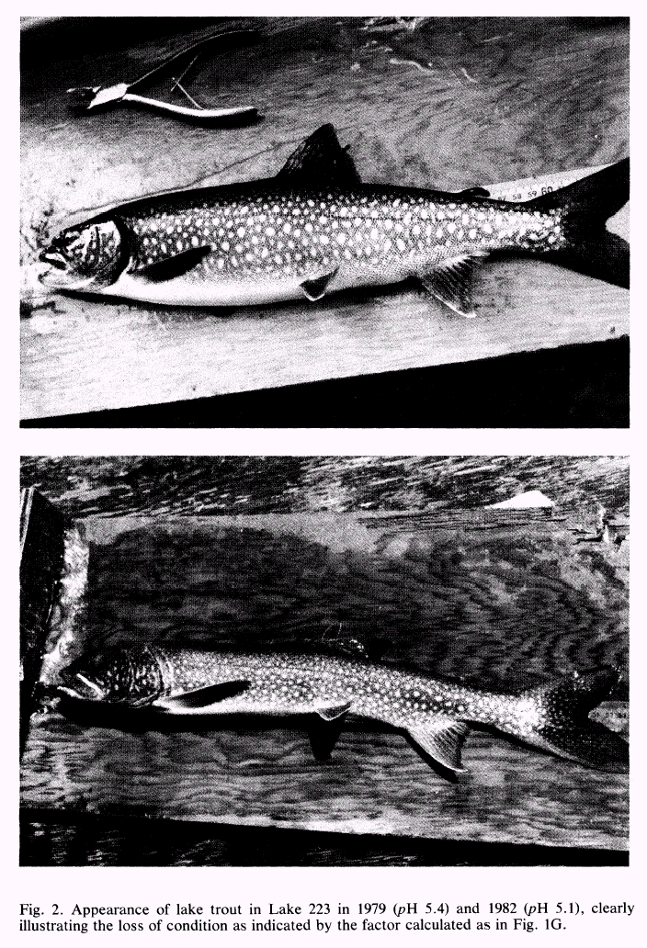
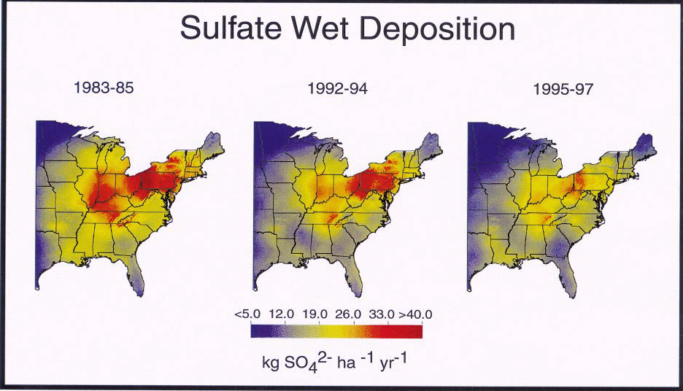
Lake trout
Lake trout on acid
(pH = 5.1)
Notes:
Figure 8. Distribution of the mean number of fish species
for ranges of pH from 4.0 to 8.0 in lakes in the Adirondack
region of New York. N represents the number of
lakes in each pH category (modified from Kretser et al.
1989).

Slide 25
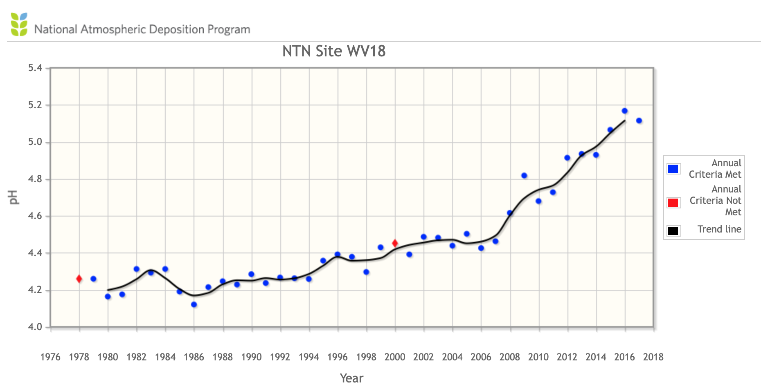
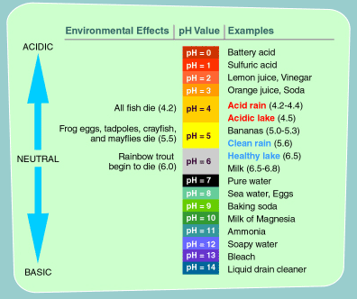
Wheeling, WV 1979
Lowest rain value recorded
pH = 1.5
Notes:
http://www.epa.gov/acidrain/education/site_students/phscale.html
Pawlick notes, "One storm in Wheeling, West Virginia, produced rain at an incredible pH 1.5-the equivalent in cor-
rosive strength to the acid in an automobile battery."4
Thomas Pawlick, A Killing Rain, The Global Threat of Acid Precipitation (1984).
Pace Environmental Law Review
Volume 2 Issue 1 1984
September 1984
T. Pawlick, A Killing Rain, e Global reat of Acid Precipitation
Robert H. Boyle

Slide 26
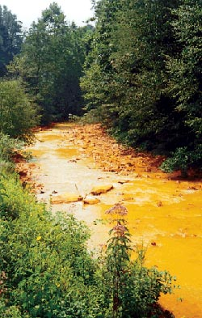
Surface reactions in mine spoil can lead to water acidification - acid mine drainage
Streams receiving this drainage could have a pH as low as 3.0!
Notes:
http://www.appalachian-center.org/issues/water/2004_apr.html for picture
http://www.osmre.gov/amdform.htm for reactions

Slide 27
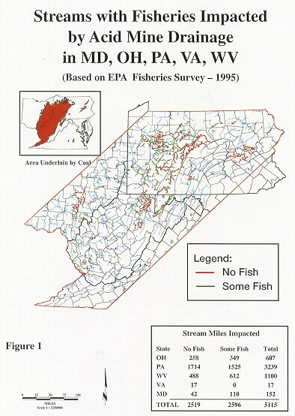

Slide 28
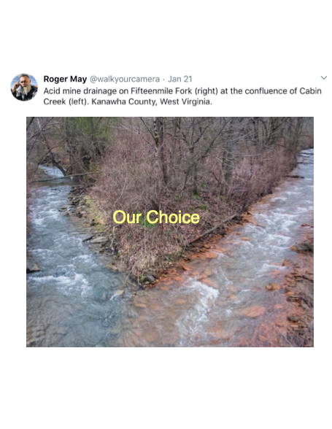

Slide 29
